Slide 1
HR STRATEGY AND FINANCIAL forecasting
BY LATI BOKA

Slide 2
Our Goals is to increase the revenue to $1000000 in net for the next year challenge
By implementing our strategies

Slide 3
HR strategy and financial forecasting
Revenue
Commission
Employees

Slide 4
2018 Revenue
Total Gross Revenue : $ 699,144,198
Total Net Revenue: $ 529,750,593
Total Number of deals closed: 20,000
Average deal amount closed per account: $ 34,957
Maximum deal per account: $ 59,994
Minimum deal per account: $ 10,000

Slide 5
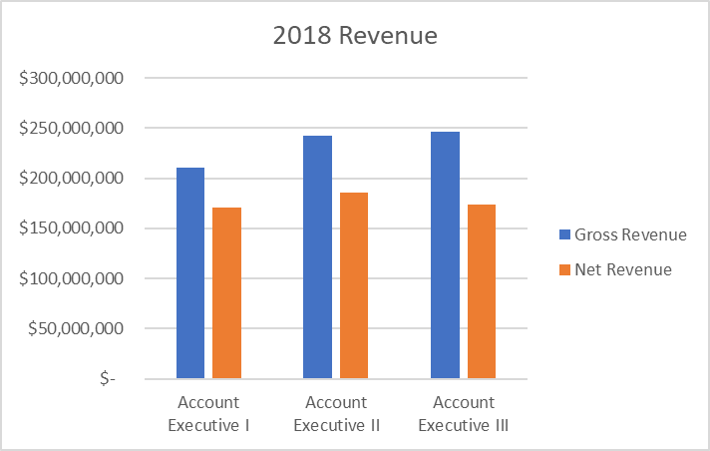
Revenue by Job Title
Executive II employees brought higher net revenue: $185,536,799

Slide 6
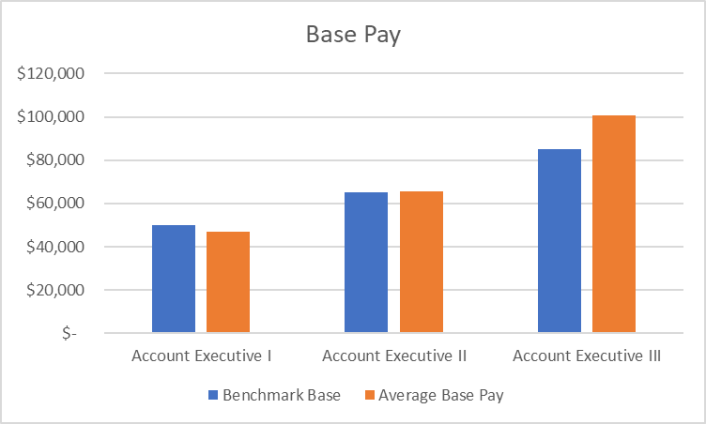
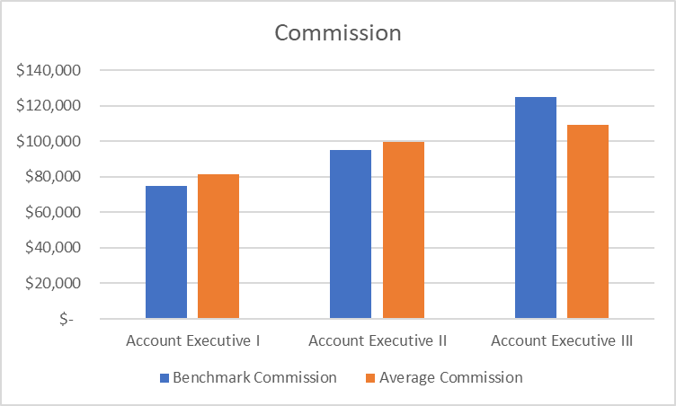
Comparison with benchmark
Higher Average base salary for Executive III employees
Less commission (on Average) for Executive III employees

Slide 7
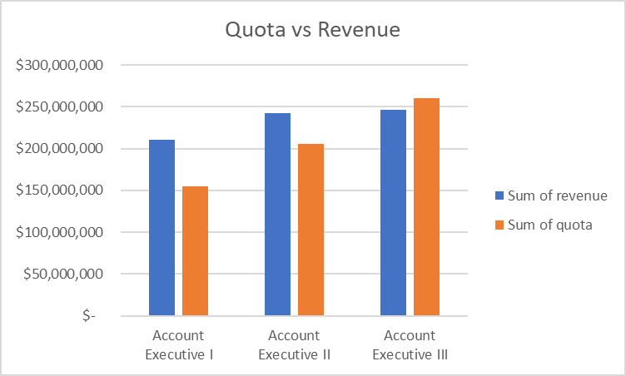
Quota
Executive I and II employees exceeded their quota

Slide 8
Recommendations
Hire more Executive I Employees
Hire mor Executive II Employees
Increase commission rates

